Slide 1


Data Collection for Research and Advocacy: Challenges and Lessons from INITIATE.MY
Hari Shankar
18 June 2025

Slide 2
Contents
Background
Why collect data?
Case Studies pt. 1 - Religious freedom & intergroup conflicts
Case Studies pt. 2 - Online extremism
Recommendations

Slide 3
Background

Slide 4
Background
What we care about
preventing/countering violent extremism (P/CVE)
Freedom of religion & belief
Social cohesion & religious/racial conflicts
Tech abuse by malicious actors
What we do
Research & data collection
Advocacy
Capacity building

Slide 5
Why collect data?
Advocate with evidence
Narratives are stronger when they’re backed with data.
Document incidents & harms
What was the impact? Don’t let people forget.
Enable further research & advocacy
Your data can enrich someone else’s analysis.

Slide 6
Case Studies - Part 1
Religious freedom & intergroup conflicts

Slide 7
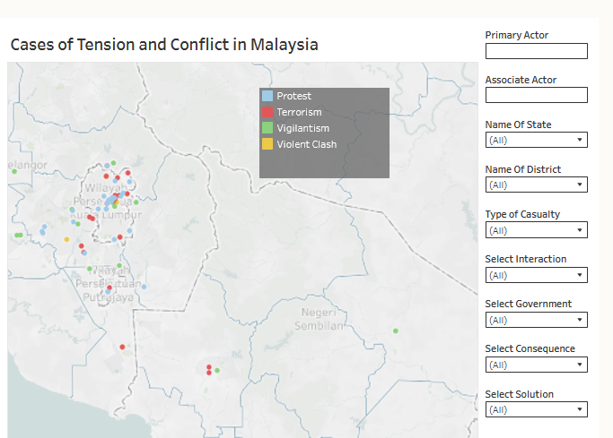
Cases of Tension and Conflict
Incidents of conflict driven by religious/racial hatred since 2004.
Data include actors, number of casualties, solutions, consequences, type of interaction, and sources!
Collected and peer-reviewed by teams of researchers

Slide 8
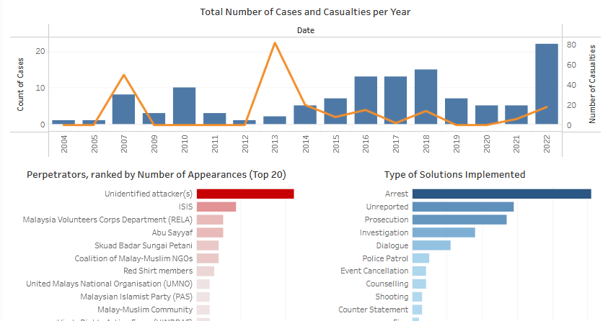
Cases of Tension and Conflict

Slide 9
Cases of Tension and Conflict
Objectives:
Promote data-driven approaches to conflict studies and counter-extremism
Trigger public discourse, research, and policy recommendations
Methods:
Media monitoring (Google Search, Wayback Machine)
Data entry and quality control
Peer-review

Slide 10
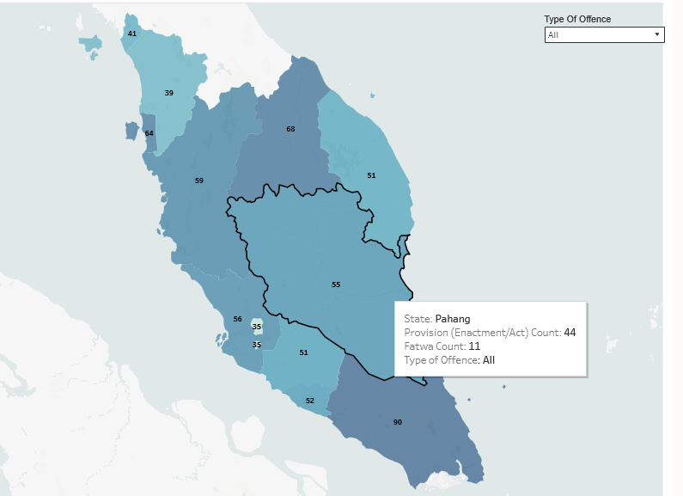
Laws that Impact Freedom of Religion and Belief
Centralised list of legislations and fatwas from years 1960 to 2025 that impact freedom of religion and belief
Entries categorised by state, source of law, jurisdiction, types of punishment, and amendment dates

Slide 11
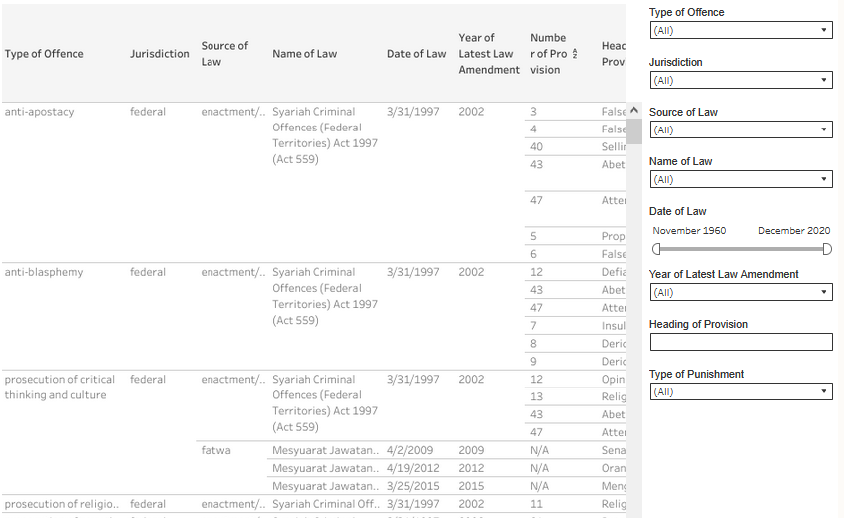
Laws that Impact Freedom of Religion and Belief

Slide 12
Laws that Impact FoRB
Objectives:
Provide an open-access centralised list of laws that affect FoRB
Increase awareness and trigger discourse on restrictions on individual freedom
Methods:
Gather legislation/fatwa copies from government databases
Contact relevant authorities (eg: JKSM) to get updated legislations
Peer-review among researchers

Slide 13
Case Studies Part 1 - Key Characteristics
“Manual” data collection by human researchers
Multiple stages of peer review and quality control
Critical discussions on frameworks and key definitions

Slide 14
Case Studies - Part 1
Lessons Learnt

Slide 15
Case Studies - Part 1
Subject matter knowledge at every stage!
Poor data quality can ruin an otherwise meaningful project.
Consider how your audience can best receive your message.
Don’t let your perceived lack of technical skills hold you back.

Slide 16
Case Studies - Part 2
Online Extremism

Slide 17

Mapping Online Hate & Violent Extremism (MAXIM)
Collected and analysed content from online platforms (TikTok, Twitter/X, Telegram) to identify dangerous narratives, actors, and dissemination tactics
Focused analysis on selected topics such as GE15, 2023 state elections, and Israel-Palestine conflict

Slide 18
Mapping Online Hate & Violent Extremism (MAXIM)
Objectives:
Elucidate narratives of hatred and violence being propagated online, and provide a risk assessment with regards to social cohesion and national security
Identify ways in which malicious actors utilise technologies such as social media and generative AI to achieve their goals
Methods:
Use open-source libraries or third-party API’s to collect data (datasets, images, videos) from social media platforms using Python scripts
Researchers provide curated list of keywords to use as search terms on social media platforms to extract relevant content
Extracted content is pushed to a Google Drive folder for researchers to review and analyse

Slide 19
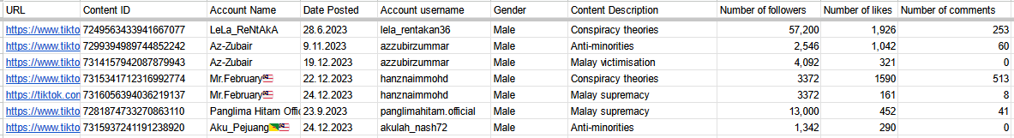
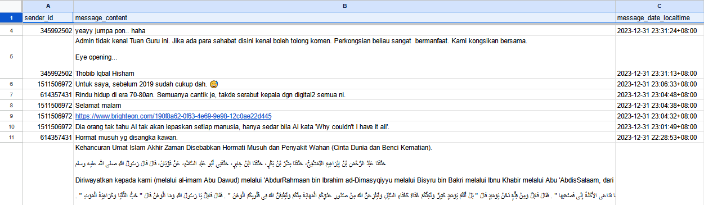
Mapping Online Hate & Violent Extremism (MAXIM)

Slide 20
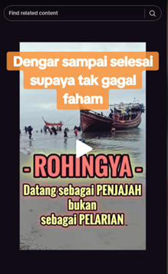




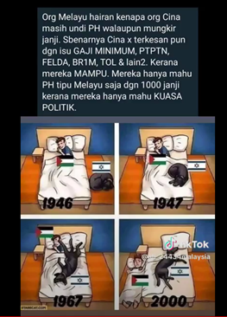
Mapping Online Hate & Violent Extremism (MAXIM)

Slide 21
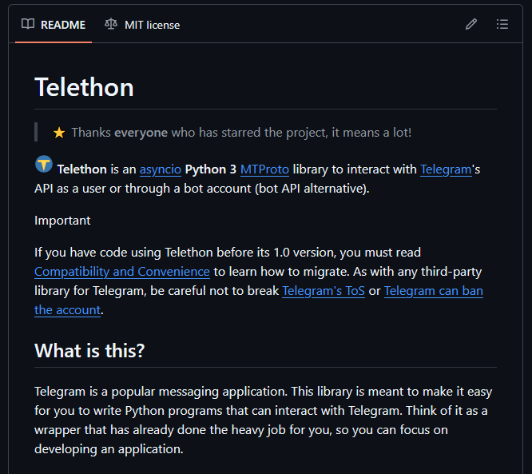
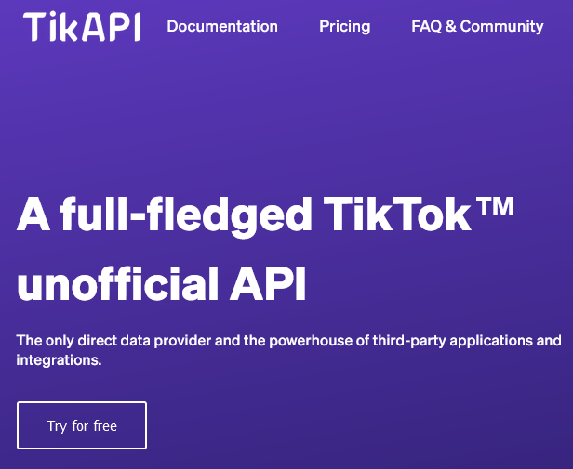
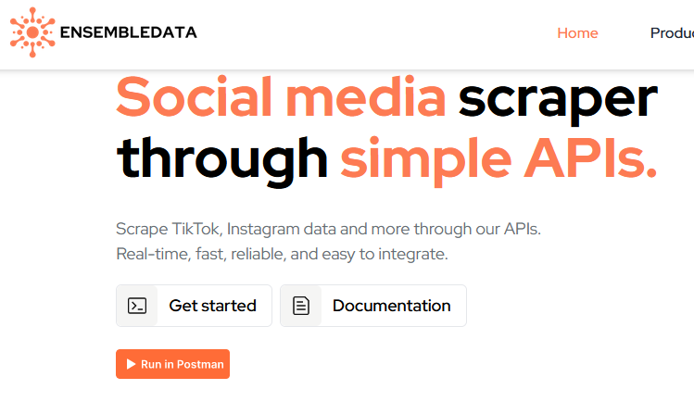
Mapping Online Hate & Violent Extremism (MAXIM)

Slide 22


Countering Right Wing & Far-Right Extremism (COUNTER)
Follow-up research project from MAXIM to identify mechanisms on how hateful content/narratives spread in social media, and how they cause real-life harm.
Improvements from MAXIM:
Curated selection of users & content for data extraction
Extract more text data for sentiment analysis
Move all data collection workloads to a single provider (Apify) for easier cost management

Slide 23
Case Studies Part 2 - Key Characteristics
Automated data collection using code-based tools
Introduction of third-party services in research process
Costs associated with data collection (third-party service fees)
LOTS of data!!
Larger presence of “false positives”, need for human review

Slide 24
Case Studies - Part 2
Lessons Learnt

Slide 25
Case Studies - Part 2
Automation/outsourcing won’t solve all your problems.
Third-party services are not flawless.
Don’t neglect cost management.
Targeted data collection strategies will save you time, and protect your sanity!

Slide 26
Recommendations

Slide 27
Recommendations
You probably already have everything you need to start collecting valuable data.
Technology can be a substitute for manpower, but NOT for subject matter expertise.
Data quality will make or break your project!
Leverage existing resources to minimise guesswork and unnecessary effort (eg: online articles/tutorials, Stack Overflow, your colleagues, forums, ChatGPT)

